Slide 1
Introductory NUCLEAR PHYSICS PHY 170 Dr. Eric K.K. Abavare

Slide 2
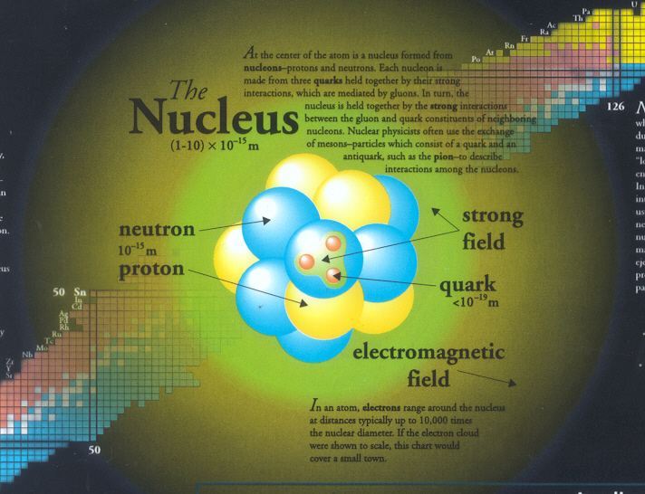

Slide 3
introduction
Elements constituent
Isotopes
Atoms found in nature are either stable or unstable
Unstable atoms are radioactive and called radionuclides
Large atomic nuclei, with more than 83 protons and their associated complement of neutrons, are inherently unstable. Uranium and plutonium are examples of such elements.
Constantly vibrate to attain stability through:
converting one to the other with the ejection of a beta particle or positron
the release of additional energy by photon (i.e., gamma ray) emission.

Slide 4
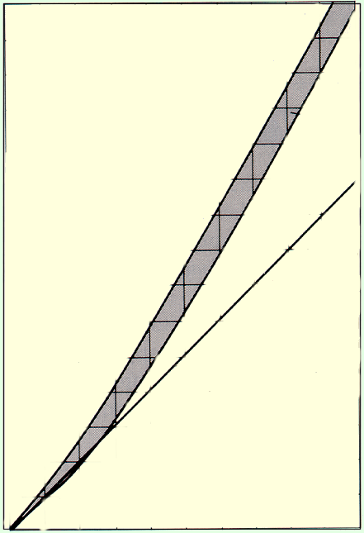
Stability Curve/Nuclidic/Segre chart
Nuclear particles are held together by a nuclear strong force.
140
Stable nuclei
120
A stable nucleus remains forever, but as the ratio of N/Z gets larger, the atoms decay.
100
80
Neutron number N
60
40
Z = N
20
Elements with Z > 83 are all unstable.
20
40
60
80
100
Atomic number Z

Slide 5
Radioactivity
As the heavier atoms become more unstable, particles and photons are emitted from the nucleus and it is said to be radioactive. All elements with A > 82 are radioactive.
α
β⁻
β⁺
γ
Examples are:
Nuclear Decay
When the unstable nuclear decays, decay products like γ-rays (high energy photons), α-particles (helium nuclei), β– particles (electrons) and β+ particles (positrons) are produced.

Slide 6
Nuclear Reactions
It is possible to alter the structure of a nucleus by bombarding it with small particles. Such events are called nuclear reactions:
General Reaction:
x + X → Y + y
For example, if an alpha particle bombards a nitrogen-14 nucleus it produces a hydrogen atom and oxygen-17:

Slide 7
Conservation Laws
For any nuclear reaction, there are three conservation laws which must be obeyed:
Conservation of Charge: The total charge of a system can neither be increased nor decreased.
Conservation of Nucleons: The total number of nucleons in a reaction must be unchanged.
Conservation of Mass Energy: The total mass-energy of a system must not change in a nuclear reaction.

Slide 8
Nuclear Decay
When the unstable nuclear decays, decay products like γ-rays (high energy photons), α-particles (helium nuclei), β– particles (electrons) and β+ particles (positrons) are produced.
Laws Governing Nuclear Decay Reactions
In nuclear decay reactions the following laws are obeyed:
1. Conservation of mass-energy.
2. Conservation of charge.
3. Conservation of linear and angular momenta.
4. Conservation of nucleons.

Slide 9
Example 7: Use conservation criteria to determine the unknown element in the following nuclear reaction:
Charge before = +1 + 3 = +4
Charge after = +2 + Z = +4
Z = 4 – 2 = 2
(Helium has Z = 2)
Nucleons before = 1 + 7 = 8
Nucleons after = 4 + A = 8
(Thus, A = 4)

Slide 10
Conservation of Mass-Energy
There is always mass-energy associated with any nuclear reaction. The energy released or absorbed is called the Q-value and can be found if the atomic masses are known before and after.
Q is the energy released in the reaction. If Q is positive, it is exothermic. If Q is negative, it is endothermic.

Slide 11
Law Radioactive Decay
In a typical radioactive decay an initial nucleus (a parent) decays by emitting a particle forming a new nucleus (a daughter). Generally,
where is the unstable parent nucleus,
is the daughter nucleus,
λ is the decay or disintegration constant and t is time.
(1)

Slide 12
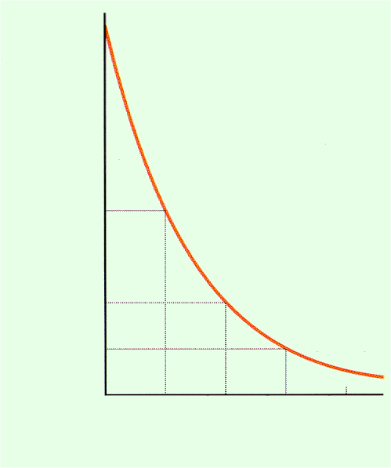
Half-Life (T_{1/2} )
This is defined as the time interval required for the number of parent nuclei present at the beginning to be reduced by a factor of one-half. Thus, using
N_{o}
Number Undecayed Nuclei
(2)
Nuclei Remaining
1
2
3
4
Number of Half-lives
Where n is number of half-lives

Slide 13
Average of Mean Life time ( Tm)
This is defined as

Slide 14
Average of Mean Life time Tm
This is defined as
(3)
Derivation
(4)
Now taking the first time differential of equation (1)
gives

Slide 15
(5)
Using (5) in (4) and changing the limits N0,0 to ,0 in terms of the time variable t gives

Slide 16
Activity
The activity (i.e. the absolute value of the rate of disintegration) of a nucleus is defined as
Activity is measured in the unit of Curie (Ci).
1 Ci = 3.7×10¹⁰ Becquerel (Bq) or disintegrations per second.
1 Bq = 1 disintegration per second.
Activity R
Number of Half-lives:

Slide 17
Example : A sample of iodine-131 has an initial activity of 5 mCi. The half-life of I-131 is 8 days. What is the activity of the sample 32 days later?
First we determine the number of half-lives:
n = 4 half-lives
The Activity is
R = 0.313 mCi
There would also be 1/16 remaining of the mass and 1/16 of the number of nuclei.

Slide 18
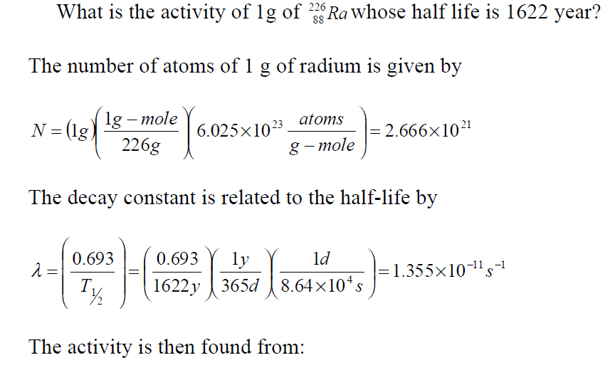

Question

Slide 19
Gamma Decay
This occurs when a nucleus in an excited energy state makes a transition to a lower energy state and accordingly emits a -ray in the process. If the nucleus makes a transition from a higher energy state Eu to a lower energy state El then
Excited nuclei are called isomers and the excited states
are referred to as isomeric states.
Example

Slide 20
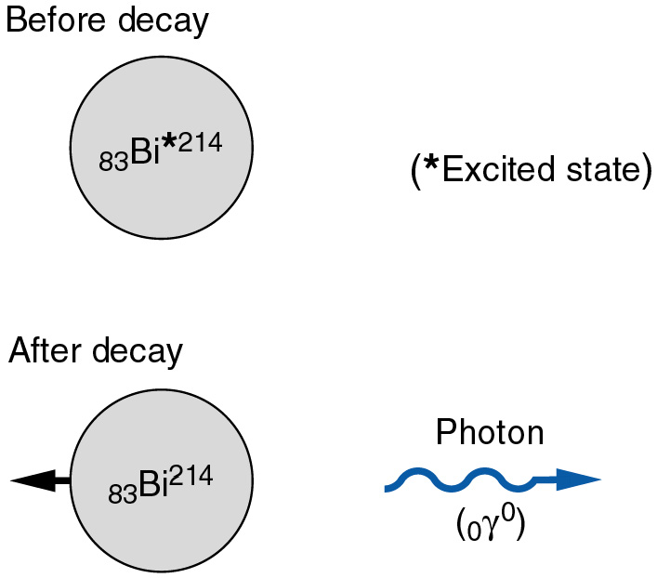
Gamma decay of bismuth-214.
The daughter isotope is a more stable (lower-energy) version of the original bismuth-214.

Slide 21
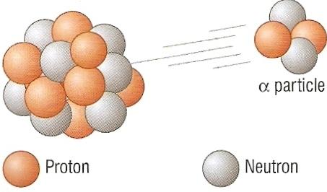
Alpha Decay
4
He
The α-particle is a helium nucleus.
Alpha particles consist of two protons plus two neutrons.
They are emitted by some of the isotopes of the heaviest elements.
2

Slide 22
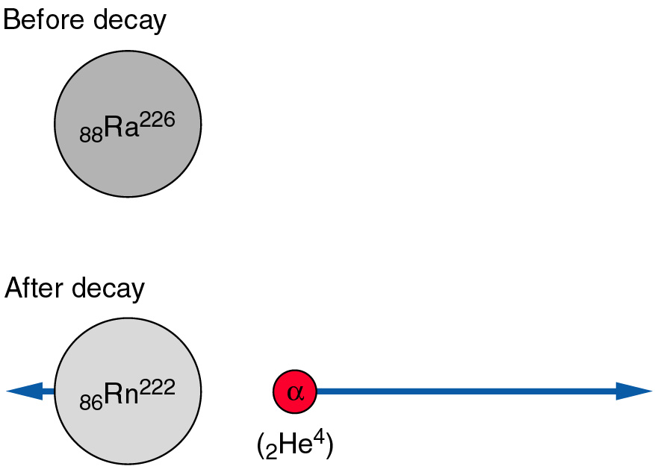
Alpha decay of Radium-226.
The daughter isotope is Radon-222.

Slide 23
Example: The decay of Uranium 238
238
234
4
U
Th
+
α
92
90
2
Uranium 238 decays to Thorium 234 plus an alpha particle.
Notes:
1. The mass and atomic numbers must balance on each side of the equation: (238 = 234 + 4 AND 92 = 90 +2)

Slide 24
Question
Show the equation for Plutonium 239 (Pu) decaying by alpha emission to Uranium (atomic number 92).
Ans:
239
235
4
Pu
U
+
α
94
92
2

Slide 25
If the parent nucleus is initially at rest then, energy conservation implies that
where KD, K_ are the kinetic energies of the daughter nuclei and MP, MD and M_ are the masses of the parent, daughter nuclei and alpha particle respectively. Since the kinetic energy can never be negative, alpha decay occurs if and only if

Slide 26
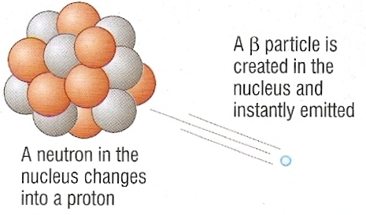
Beta Decay
Beta particles consist of high speed electrons.
They are emitted by isotopes that have too many neutrons.
One of these neutrons decays into a proton and an electron. The proton remains in the nucleus but the electron is emitted as the beta particle.

Slide 27
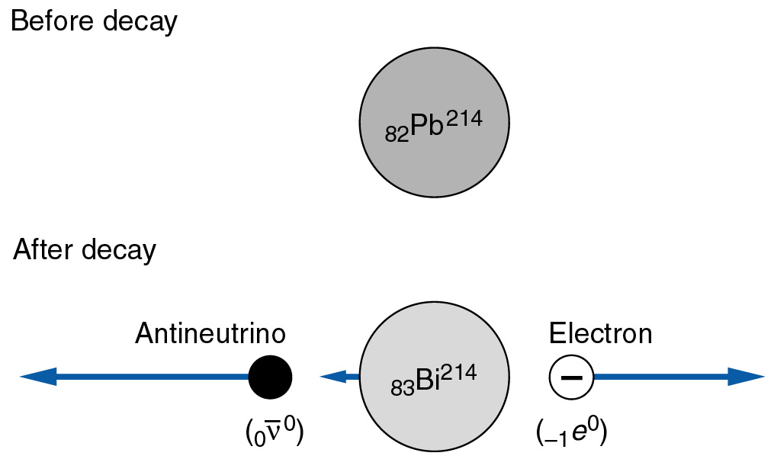
Beta decay of Lead-214.
The daughter isotope, Bismuth-214, has a higher atomic number than Lead.

Slide 28
Beta Decay
^{A}Z → ^{A}(Z+1) + e⁻ + an anti-neutrino
A neutron has converted into a proton, electron and an anti-neutrino.
Positron Decay
^{A}Z → ^{A}(Z-1) + e⁺ + a neutrino
A proton has converted into a neutron, positron and a neutrino.
Electron Capture
^{A}Z + e⁻ → ^{A}(Z-1) + a neutrino
A proton and an electron have converted into a neutron and a neutrino.

Slide 29
Example: The decay of Carbon 14
14
14
0
C
N
+
β⁻
6
7
-1
Carbon 14 decays to Nitrogen 14 plus a beta particle.
Notes:
1. The beta particle, being negatively charged, has an effective atomic number of minus one.
2. The beta particle can also be notated as:
0
e
-1

Slide 30
Question
Show the equation for Sodium 25 (Na), atomic number 11, decaying by beta emission to Magnesium (Mg).
25
25
0
Na
Mg
+
β⁻
11
12
-1

Slide 31
Several Decay Processes:
Electron capture:
γ decay:
α decay:
β⁻ decay:
β⁺ decay:

Slide 32
Problems
Derive the decay law
2. What is the activity of one gram of whose half life is 1622 years?
3. Over what distance in free space will the intensity of a 5 eV neutron beam be reduced by a factor of one-half? ( T ½ = 12.8 min)

Slide 33
Changing Elements
Both alpha and beta decay cause the an isotope to change atomic number and therefore element. Alpha decay also causes a change in mass number.
Decay type | Atomic number | Mass number
alpha | DOWN by 2 | DOWN by 4
beta | UP by 1 | NO CHANGE
gamma | NO CHANGE | NO CHANGE

Slide 34
NUCLEAR FISSION
Fission is a phenomenon by which an unstable nucleus disintegrates into two smaller nuclides of approximately the same order of mass as well as the emission of ionizing radiations or particles with the release of nuclear energy.
There are 2 types of fission that exist:
1. Spontaneous Fission
2. Induced Fission

Slide 35
Spontaneous Fission
Some radioisotopes contain nuclei which are highly unstable and decay spontaneously by splitting into 2 smaller nuclei.
Such spontaneous decays are accompanied by the release of neutrons.

Slide 36
Induced Fission
Nuclear fission can be induced by bombarding atoms with neutrons.
The nuclei of the atoms then split into 2 equal parts.
Induced fission decays are also accompanied by the release of neutrons.

Slide 37
Examples of Fission Reactions

Slide 38
Equivalence of mass and energy (E=mc²)
An atomic particle at rest possess a rest mass energy E₀ given by
where m₀ is the rest mass and c is the speed of electromagnetic waves in vacuum.
2. A dynamic particle possesses both kinetic energy and rest mass energy, the sum of which is known as dynamic energy E. Mathematically,
where m is dynamic mass, ER = rest mass energy and E_{K} = kinetic mass energy

Slide 39
3. Hence, for moving atomic particles,
4. But for photons
since photons have zero rest masses as they are quanta of electromagnetic radiations moving with the speed of light
(c = m/s).

Slide 40
Mass Defect
It has been experimentally proven that when an atomic nucleus disintegrates into its constituent nucleons, the total mass (i.e. rest mass) of the nucleons is usually more than that of the initial nucleus or nuclide. This difference in mass is known as the mass defect. Thus,

Slide 41
The nuclear binding energy is a consequence of the mass defect. The example below illustrates this point. Consider the reaction
where X s the initial nuclide and a and b are nucleons. Then sum of the masses of nucleons = ma + mb and mass of X is mx. But

Slide 42


Disintegration Energy(Q)
A particle undergoing a translational motion in space-time continuum must possess both rest mass energy and kinetic energy. In such a case the total energy of the particle is given by
Assume that in the reaction : X(a, b)Y, Z all the particle i.e. a ,b and the nuclides possess non-zero translational kinetic energy (mass energy). The total energies of the individual nuclides and particles are calculated as follows:
where ‘m’ is in ‘kg’ and ‘c’ is in ‘m/s’.

Slide 43
UNITS
Note that, in usual nuclear calculation, you may encounter atomic masses in either kilogram or unified atomic units.
Please, make sure you use consistent units:
1u =1.6605402 x 10⁻²⁷kg

Slide 44
Energy from Fission
235
U
1
n
138
Cs
96
Rb
1
n
+
+
+
2
92
0
55
37
0
Element | Atomic Mass (kg)
²³⁵₉₂U | 3.9014 x 10⁻²⁵
¹³⁸₅₅Cs | 2.2895 x 10⁻²⁵
⁹⁶₃₇Rb | 1.5925 x 10⁻²⁵
¹₀n | 1.6750 x 10⁻²⁷

Slide 45
Worked Eample
For the reaction
The mass defect is computed as follows:
Mass of nucleons = 2(1.0073u) + 2(1.0087u) = 4.032u
Mass defect = 4.032 u - 4.00154 u = 0.03046 u

Slide 46
But E = mc²
Hence, mass defect
= 0.03046 × c2
= 0.03046 × 931 Mev

Slide 47
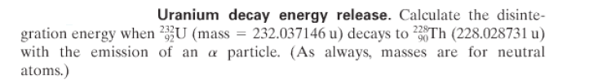


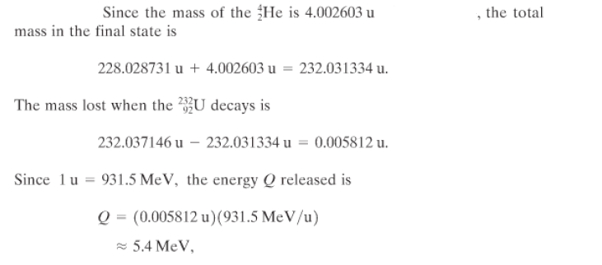
Question :
Solution:
+

Slide 48
Energy release in nuclear reaction

Slide 49
Nuclear Reactor Parts
Bombarding Particles of Appropriate Energies
Fuel rods
These contain U235 or Pu239. They become very hot due to nuclear fission.
Control rods
Made of boron, when placed in-between the fuel rods these absorb neutrons and so reduce the rate of fission. Their depth is adjusted to maintain a constant rate of fission.
Moderator
This surrounds the fuel rods and slows neutrons down to make further fission more likely. The moderator can be water or graphite.
Coolant
This transfers the heat energy of the fuel rods to the heat exchanger. Coolant be water, carbon dioxide gas or liquid sodium.
Heat exchanger
Here water is converted into high pressure steam using the heat energy of the coolant.
Reactor core
This is a thick steal vessel designed to withstand the very high pressure and temperature in the core.
Concrete shield
This absorbs the radiation coming from the nuclear reactor.

Slide 50
Nuclear Fusion
Fusion is a nuclear phenomenon by which two small masses of high atomic nuclides under controlled thermo-nuclear conditions aggregate into a composite (single) atomic nuclide with the consequent release of nuclear energy. Fusion is one of the methods by which energy can be obtained from the nucleus. The fusion process is termed as thermo-nuclear process because it requires an initial input of thermal energy of a very great magnitude and consequently requires super-high temperatures (of the order of 10⁶ K) for ignition. Nevertheless, the fusion process after it has been triggered produces a large avalanche of nuclear energy. A few examples of fusion reaction are listed below:

Slide 51
The Fusion Process
2
H
1
3
H
1

Slide 52
Energy from Fusion
2
H
3
H
4
He
1
n
Energy
+
+
+
1
1
2
0
Element | Atomic Mass (kg)
²₁H | 3.345 x 10⁻²⁷
³₁H | 5.008 x 10⁻²⁷
⁴₂He | 6.647 x 10⁻²⁷
¹₀n | 1.6750 x 10⁻²⁷

Slide 53
or
or

Slide 54
Theoretical Background for the Computation of Q Value
A particle undergoing a translational motion in space-time continuum must possess both rest mass energy and kinetic energy. In such a case the total energy E_{T} of the particle is given by
General Case:

Slide 55
Assume that in the above reaction all the particle i.e. a,b and the nuclides possess non-zero translational kinetic energy (mass energy). The total energies of the individual nuclides and particles are calculated as follows:
X:
where m₀ is in kg and c is in ms^{–1}.
a:
b:
Z:

Slide 56
Conservation of mass in nuclear reactions implies that the energy of the interacting system is equal to the energy of the resultant system. Thus,
But 1u (atomic mass unit amu) = 931 MeV
Q =
MeV

Slide 57
Energy from Fusion
Calculate the following:
The mass difference.
The energy released per fusion.

Slide 58
Energy from Fusion
2
H
3
H
4
He
1
n
Energy
+
+
+
1
1
2
0
The total mass before fusion (LHS of the equation):
3.345 x 10⁻²⁷ + 5.008 x 10⁻²⁷ = 8.353 x 10⁻²⁷ kg
The total mass after fission (RHS of the equation):
6.647 x 10⁻²⁷ + 1.675 x 10⁻²⁷ = 8.322 x 10⁻²⁷ kg

Slide 59
Energy from Fusion
m = total mass before fission – total mass after fission
m = 8.353 x 10⁻²⁷ – 8.322 x 10⁻²⁷
m = 3.1 x 10⁻²⁹ kg

Slide 60
Energy from Fusion
2
H
3
H
4
He
1
n
Energy
+
+
+
1
1
2
0
m = 3.1 x 10⁻²⁹ kg
E = mc²
c = 3 x 10⁸ ms⁻¹
E = 3.1 x 10⁻²⁹ x (3 x 10⁸)²
E = E
E = 2.79 x 10⁻¹² J
The energy released per fusion is 2.79 x 10⁻¹² J.

Slide 61

ACCELERATED CHARGES AND BREMSSTRAHLUNG
Radiation from Accelerated, Charged Particles
A charged particle undergoing acceleration radiates photons. A ready example of this is when electrons moving back and forth in antennae produce electromagnetic radiation, such as transmitted by radio stations.
The power in electromagnetic radiation emitted by a particle of charge (q )with an acceleration a is given by Larmor's formula:

Slide 62
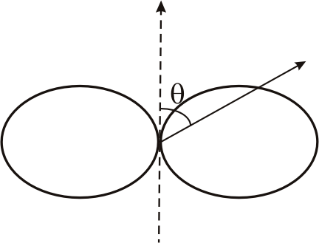
The radiation has some very interesting properties:
• the emitted power, P, is proportional to the square of the charge( q²) and the square of the acceleration (a²).
the photons are emitted in a characteristic dipolar form.
Maximum emission takes place perpendicular to the direction of the acceleration, and is proportional to sin²θ.
(P α sin²θ)
Dipolar emission from an accelerated charge

Slide 63
Bremsstrahlung from an Electron Passing a Charged Particle
Bremsstrahlung, or braking radiation, is emitted when a charged particle moves in an electric field, E. The particle emits energy in the form of electromagnetic radiation, at the expense of its kinetic energy, hence the name ``braking radiation''.
The major astrophysically relevant example of bremsstrahlung, is when anelectron, e− with velocity v, passes a charge consisting of Z protons, with total charge Ze+. The impact parameter b of the interaction is the distance of closest approach.
The electron is accelerated during its interaction, and since the acceleration is not uniform it emits photons with a range of wavelengths, i.e. a spectrum.

Slide 64
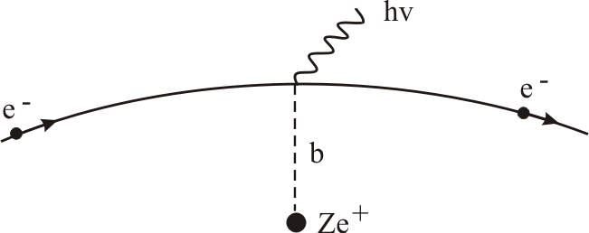
Bremsstrahlung radiation. An electron e- passes an ion with charge Ze+ with an impact parameter, b. Forces acting on the charge during the passage cause the emission of photons, hv.

Slide 65
The electron is accelerated during its interaction
If acceleration is not uniform it emits photons with a range of wavelengths, i.e. a spectrum.
The power emitted can be computed from Larmor's formula
flat spectrum in frequency with an upper cutoff, ω_{cut}), which is related to the interaction time, Δ t = v/b, or interaction frequency w = 1/Δt = b/v, is produced.

Slide 66
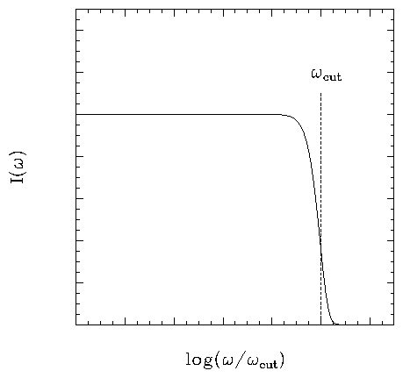
The intensity in the flat part of the spectrum, where (ω< ω_{cut}) is given by

Slide 67
Dating Techniques
Four Categories
Radio-isotope methods
Paleomagnetic methods
Organic/inorganic chemical methods
Biological methods

Slide 68
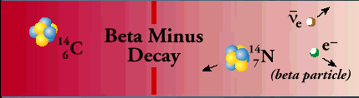
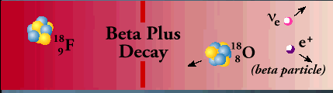
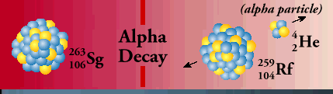
Radio-isotopic Method
Based on disintegration of unstable nuclei
Negatron decay (n p⁺ + β⁻ + energy)
Positron decay (p⁺ n + β⁺ + energy)
Alpha decay (^{A}X ^{A-4}Y + He)

Slide 69
To be a useful for dating, radio-isotopes must:
be measurable
have known rate of decay
have appropriate t_{1/2}
have known initial concentrations
be a connection between event and radioisotope

Slide 70
Carbon dating
Carbon has 3 isotopes:
¹²C – stable
¹³C – stable
¹²C:¹³C = 98.89 : 1.11
¹⁴C – radioactive
Abundance:

Slide 71
Radiocarbon (¹⁴C) formation and decay
-formed by interaction of cosmic ray spallation products
with stable N gas
-radiocarbon subsequently decays by β- decay back to
¹⁴N with a half-life of 5730y
The activity of radiocarbon in the atmosphere represents a balance of its production, its decay,and its uptake by the biosphere, weathering, etc.

Slide 72
Radiocarbon (¹⁴C) formation and decay
formed by interaction of cosmic ray spallation products with stable N gas
radiocarbon subsequently decays by ⁻ decay back to ¹⁴N with a half-life of 5730 yr
Radiocarbon dating was first explored by W.R. Libby (1946), who later won the Nobel Prize.
Most published dates still use the “Libby” half-life of 5568y to enable comparison of ¹⁴C dates.
Which of these three
things might change
through time,
and why?
The activity of radiocarbon in the atmosphere represents a balance of its production, its decay, and its uptake by the biosphere, weathering, etc.

Slide 73
Radiocarbon Dating
As plants uptake C through photosynthesis, they take on the 14C activity of the atmosphere.
Anything that derives from this C will also have atmospheric ¹⁴C activity (including you and I).
If something stops actively exchanging C (it dies, is buried, etc), that 14C begins to decay.

Slide 74
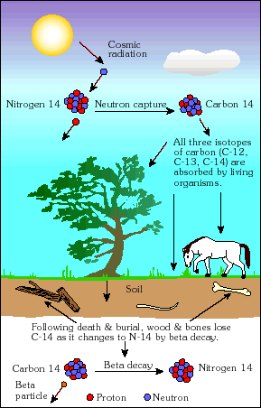
Radiocarbon
Forms:
in the upper atmosphere
Decays:
t ½ = 5730 yr.
Notes:
נוצר באטמוספירה העליונה על ידי פגיעה של קרניים קוסמיות בחנקן 14,
מיד לאחר היווצרותו, מתרכב הפחמן עם חמצן ויוצר פחמן חד חמצני ופחמן דו חמצני שמומס באוקיינוסים ונכנס לביוספרה גם על ידי פוטוסינתזה.

Slide 75
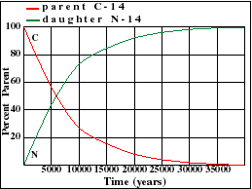
Calculated
Measured
???
Constant
Half life time

Slide 76
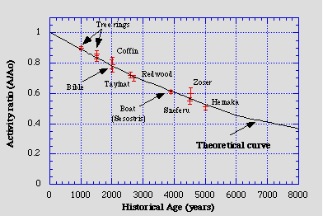
Radiocarbon Dating
1) As plants uptake C through photosynthesis, they take on the ¹⁴C activity of the atmosphere.
2) Anything that derives from this C will also have atmospheric ¹⁴C activity (including you and I).
3) If something stops actively exchanging C (it dies, is buried, etc), that ¹⁴C begins to decay.
where present-day, pre-bomb,
¹⁴C activity = 13.56dpm/g C
So all you need to know to calculate
an age is A₀, which to first order
is 13.56dpm/g, BUT
*small variations (several percent)
in atmospheric ¹⁴C in the past
lead to dating errors of up to 20%!
Sources of variability:
Geomagnetic field strength
Solar activity
Carbon cycle changes

Slide 77
Radiocarbon Measurements and Reporting
Radiocarbon dates are determined by measuring the ratio of ¹⁴C to ¹²C in a sample, relative to a standard, usually in an accelerator mass spectrometer.
standard = oxalic acid that represents activity of 1890 wood
14C ages are reported as “¹⁴C years BP”, where BP is 1950
Most living things do not uptake C in atmospheric ratios -- they fractionate carbon, (lighter ¹²C preferentially used), must correct for this fractionation because it affects the ¹⁴C/¹²C ratio
Collect the ¹³C/¹²C ratio, use it to correct for “missing” ¹⁴C
So the less ¹³C a sample has, the less ¹⁴C it has,
and so the uncorrected ¹⁴C age will be _______
than the calendar age?
Samples are “normalized” to a δ¹³C_{PDB} value of -25‰
The final step is to obtain a “calibrated ¹⁴C age” using the atmospheric radiocarbon content when the sample grew.

Slide 78
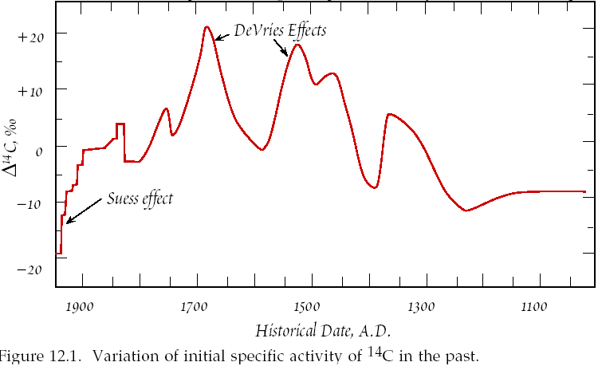
Atmospheric radiocarbon variability through time
Convention:
The atmospheric radiocarbon
anomaly with respect to a standard is defined as Δ¹⁴C
solar activity changes
Note:
the Δ¹⁴C is 0 during 1890, b/c that’s
the activity of the
oxalic acid standard
addition of isotopically light
fossil fuel C to atmosphere
time
But how did somebody
construct this curve?

Slide 79
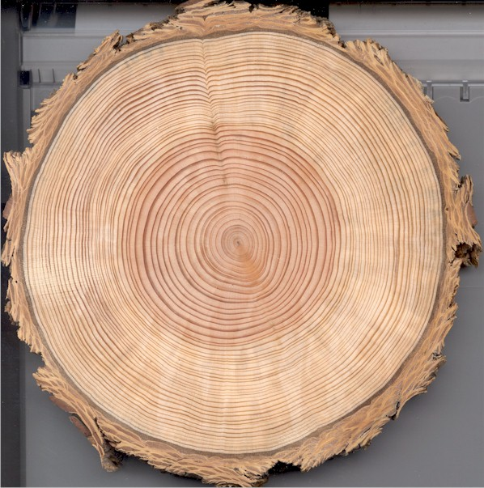
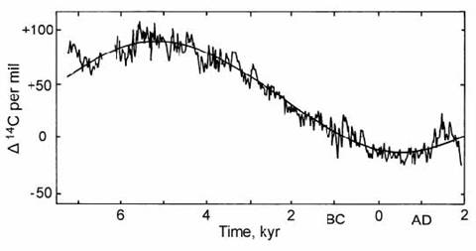
Reconstructing atmospheric radiocarbon variability through time
What you need:
absolute age & radiocarbon age
What you get:
history of ¹⁴C_{atmos}
radiocarbon
sampling
transect
tree cut in 1999A.D.
1821A.D. by ring-counting
Most of the Holocene ¹⁴C_{atmos}
variability derives from changes
in the geomagnetic field

Slide 80
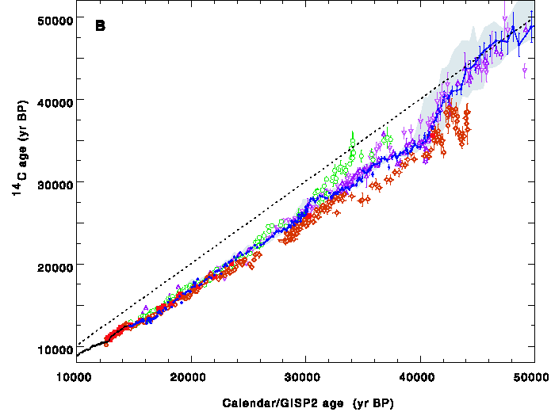
The Radiocarbon Calibration Curve (atmospheric ¹⁴C history)
Principle: compare radiocarbon dates with independent dates
Examples of independent dating: tree-ring counting, coral U-Th dates, varve counting,
correlation of climate signals in varves with ice core
data from:
corals (bright red)
lake varves (green)
marine varves (blue)
speleothems (orange)
tree rings (black)
Observation:
radiocarbon dates
are consistently younger than calendar ages
equiline
time
Hughen et al., 2004

Slide 81
So all you need to know to calculate
an age is A₀, which to first order
is 13.56dpm/g, BUT
*small variations (several percent)
in atmospheric ¹⁴C in the past
lead to dating errors of up to 20%!
Sources of variability:
geomagnetic field strength
solar activity
carbon cycle changes

Slide 82
Radiocarbon Measurements and Reporting
1) Radiocarbon dates are determined by measuring the ratio of ¹⁴C to ¹²C in a sample, relative to a standard, usually in an accelerator mass spectrometer.
standard = oxalic acid that represents activity of 1890 wood
14C ages are reported as “¹⁴C years BP”, where BP is 1950
2) Fact: Most living things do not uptake C in atmospheric
ratios – i.e. they fractionate carbon,
(lighter ¹²C preferentially used), must correct for this
fractionation because it affects the ¹⁴C/¹²C ratio

Slide 83
Researchers collect the ¹³C/¹²C ratio, use it to
correct for “missing” ¹⁴C
So the less ¹³C a sample has, the less ¹⁴C it has,
and so the uncorrected ¹⁴C age will be _______
than the calendar age?
Samples are “normalized” to a δ¹³C_{PDB} value of -25‰

Slide 84
3) The final step is to obtain a “calibrated ¹⁴C age”
using the atmospheric radiocarbon content
when the sample grew.

Slide 85
Atmospheric Radiocarbon Variability
through Time
Convention:
The atmospheric radiocarbon anomaly with respect to a standard is defined as D¹⁴C

Slide 86
Note:
the Δ¹⁴C is 0
during 1890,
b/c that’s
the activity of the
oxalic acid standard
addition of isotopically light
fossil fuel C to atmosphere
time
VARIATION OF INITIAL SPECIFIC ACTIVITY OF C-14 IN THE PAST

